Slide 1
Salivary glands and saliva
Dr.Deepa G.S
Asso.Professor
Dept.of Physiology
SKHMC

Slide 2
Salivary galnds
Parotid
Submaxillary or submandibular
Sublingual

Slide 3
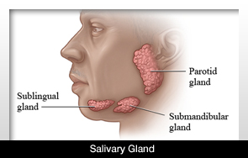
Salivary Glands

Slide 4
Parotid gland
Largest salivary gland
Weight:20-30g
Location:Just below and front of the ear
Duct:Stenson’s ducopens at a point opposite the crown of the second upper molar teeth on the cheek

Slide 5
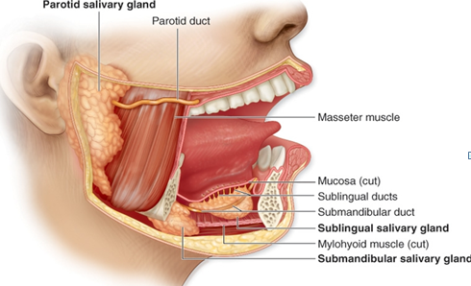
Salivary Glands

Slide 6
Submaxillary gland
Weight:8-10g
Location:in the submandibular triangle
Duct:Wharton’s duct,opening into the floor of the mouth on either side of frenulum of tongue

Slide 7
Sublingual glands
Location:beneath the tongue under the mucus
membrane of oral cavity
Duct:drained by 5-15 small ducts opening into
the floor of mouth,ducts of Rivinus and
bartholin

Slide 8
Minor salivary glands
Lingual serous
Lingual mucus
Buccal glands
Labial glands
Palatal glands

Slide 9
Classification
Serous-Parotid ,lingual serous
Mucus-buccal,palatal,lingual mucus
Mixed-submandibular,sublingual,labial

Slide 10
Percentage of salivary secretion
Parotid-20% of total saliva
Sublingual-5%
Submandibular-70%

Slide 11
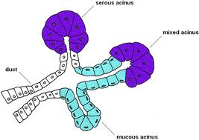
Histology

Slide 12
Nerve supply
Efferent nerve supply:Parasympathetic nerves
Parotid gland- originates from superior salivatory nucleus ie:dorsal nucleus of Glossopharyngeal nerve (IX)
Submandibualr and sublingual gland- originates from inferior salivatory nucleus
ie: dorsal nucleus of facial nerve(VII)

Slide 13
Efferent nerve supply:Parasympathetic nerves
Function
Secretion of saliva with large quantity of water

Slide 14
Nerve supply
Afferent
Chorda tympani branch of VII nerve and IX nerve
Sympathetic
Originates from lateral horn cells of T1,2 segments of spinal cord
Function: secretion of thick saliva rich in organic constituents and mucus

Slide 15
Gland type and weight | Location | Route of the secretory duct | Histology | Percentage of total salivary secretion | Sourec of parasympathetic nerve supply
Parotid 20-30gm each | In front of the ears | Stenson’s duct Opens opposite to the second molar tooth | Purely serous cells | 25% | IX nerve
Submandibular or sublingual 8-10gm each | Medial to the mandible in the submaxillary triangle | Wharton’s duct Opens into the floor of mouth along the side of frenulum of tongue | Mixed cells Serous and mucus cells in the ratio 4:1 | 70% | VII nerve
Sublingual 2-3gm each | Subjacent t o the floor of the mouth | 5-15 small ducts-Ducts of Rivinus Opens into the sublingual parts of mouth | Mixed cells Serous and mucus cells in the ratio 1:4 | 5% | VII nerve

Slide 16
Properties and composition
Properties
Volume:1-1.5litres
Reaction-6.35-6.85,slightly acidic
Sp.gravity:1.002 and1.012

Slide 17
Composition
Water-99.5%
Slids-0.5%

Slide 18
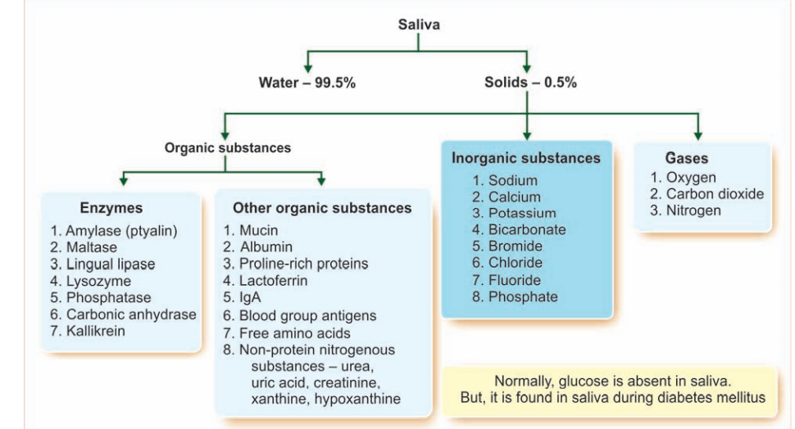
Composition of saliva

Slide 19
Functions
Preparation of food for swallowing
Appreciation of taste
Digestive
Role in speech
Excretory
Regulation of body temp and water balance

Slide 20
Functions
Cleansing
Lysozyme
Proline rich proteins-maintain pH at 7 ,at this pH saliva is saturated with calcium therefore do not lose ca;lcium to oral fluids
Mucin- lubrication
IgA –antibacterial and antiviral
Lactoferrin-Antimicrobial property

Slide 21
Regulation of salivary secretion

Slide 22
Applied physiology
1.Hyposalivation:
Temporary:
Emotional conditions
Fever
Dehydration
Permanent:
Sialolithiasis

Slide 23
Aptyalism or xerostomia
Bell’s palsy
2.Hypersalivation:(Sialorrhea or Ptyalism)
Pregnancy
Decay of tooth
Neoplasm of tongue or mouth
Disease of esophagus,stomach and intestine

Slide 24
Parkinsonism
Psychological and psyhiatric conditions
Nausea and vomiting
3.Chorda tympani syndrome
4.Paralytic secretion of saliva
5.Mumps: Paramyxo virus
5.Sjogren’s syndrome

